Slide 1
2. Local hero
Developers:
Tomáš Balluch
Aleš Buľko
Matej Čupka
Hoai Thuong Do
Lucia Michalenková
Consultant from Hotovo:
Ing. Patrik Figura
Consultant from TUKE:
Ing. William Steingartner PhD.

Slide 2
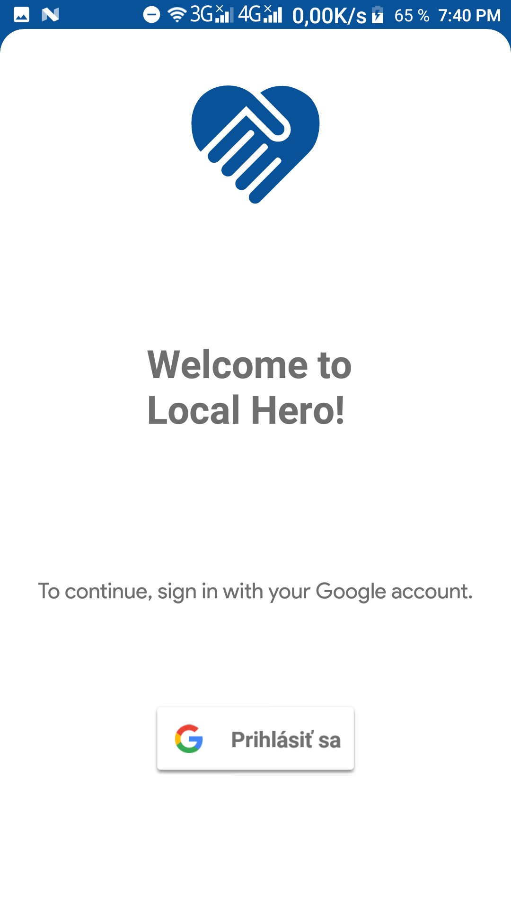
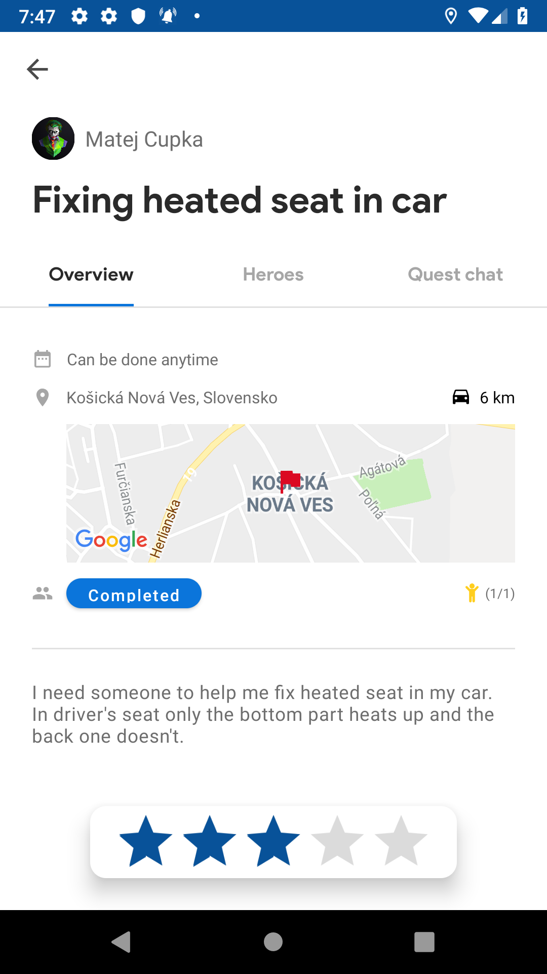
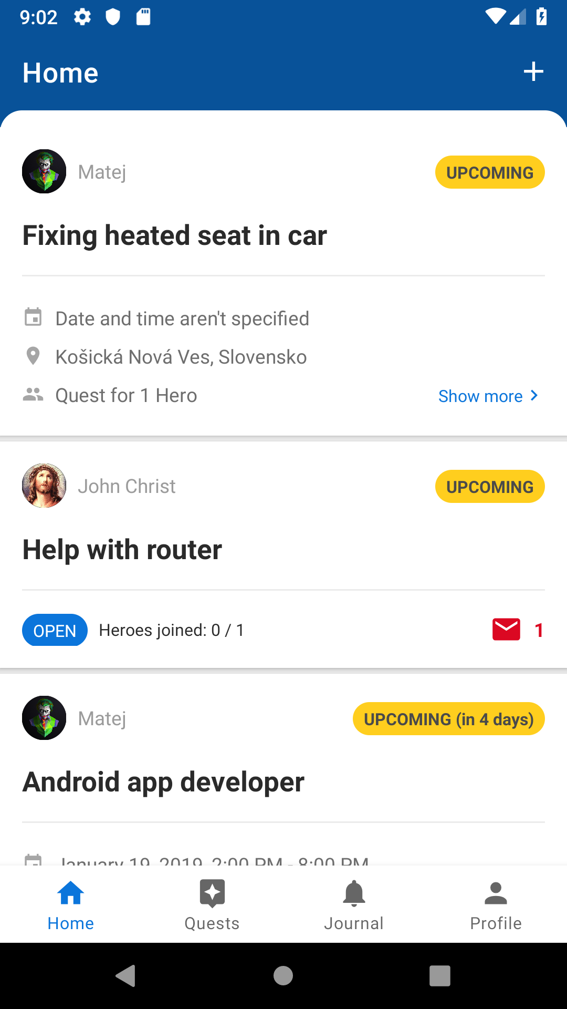
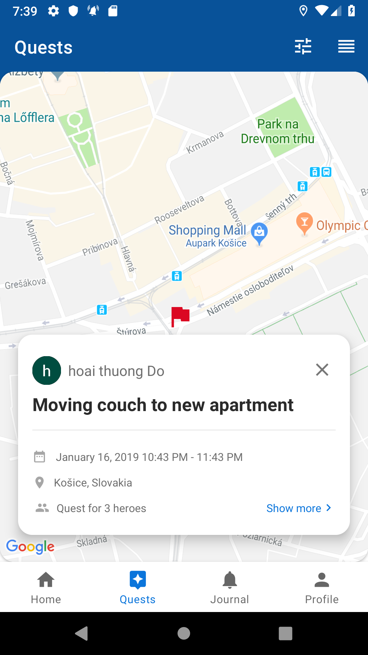
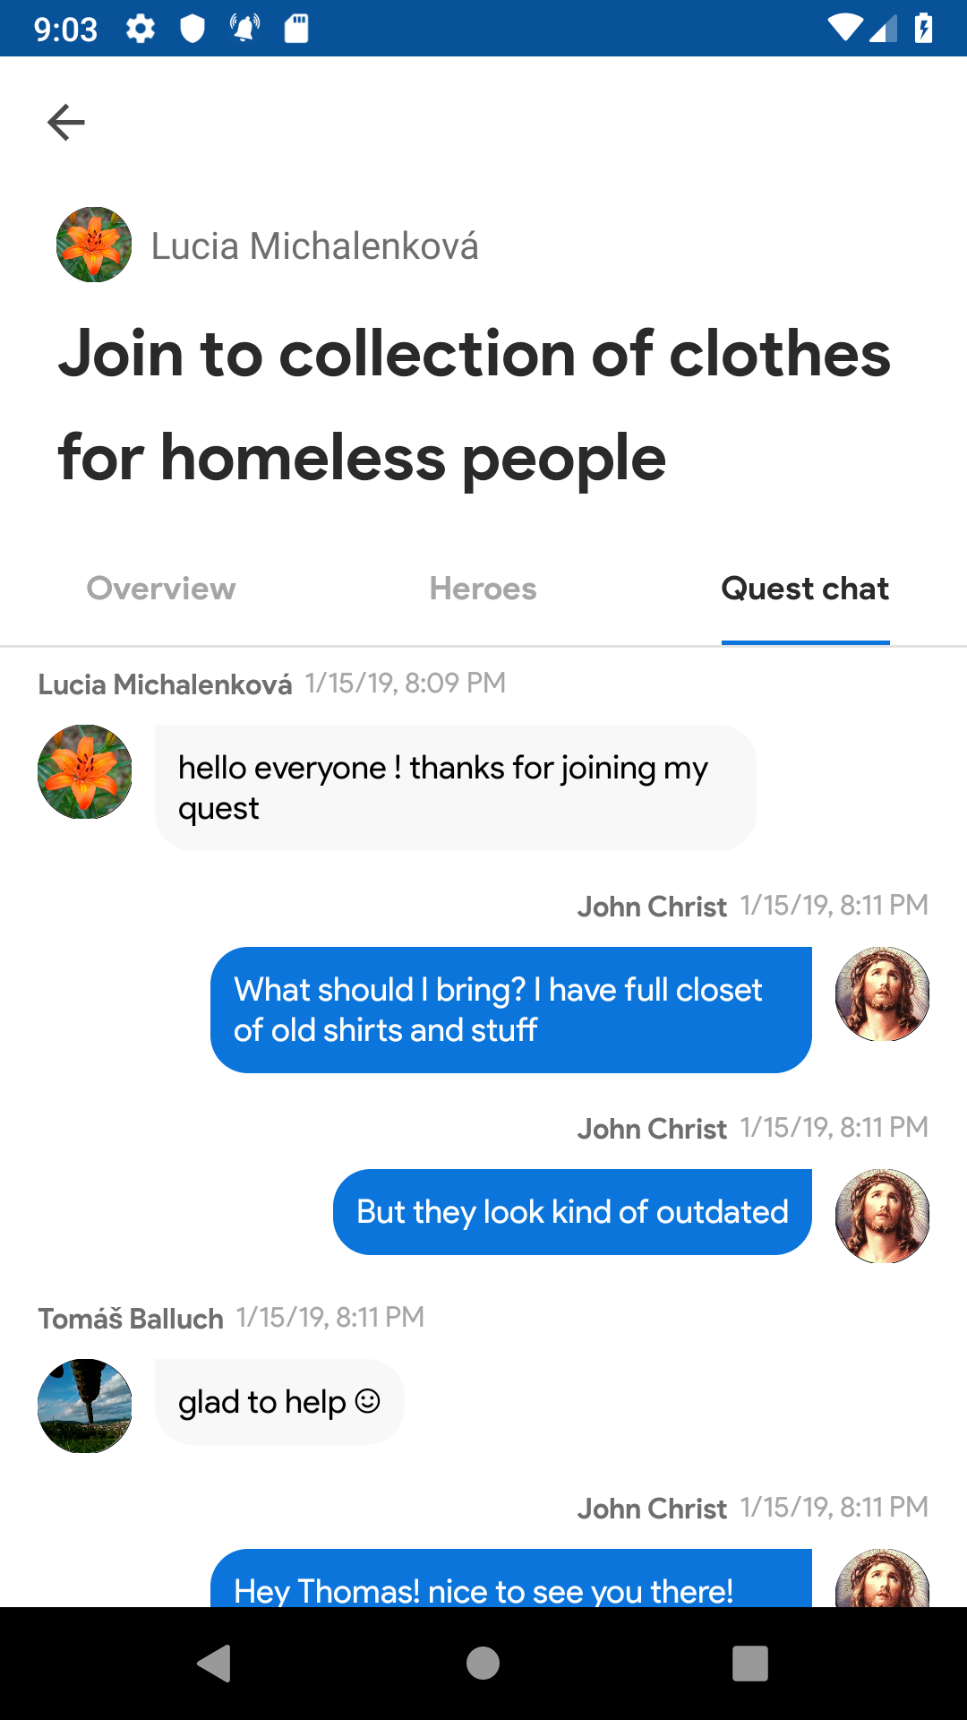
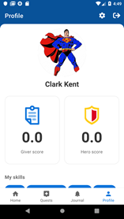
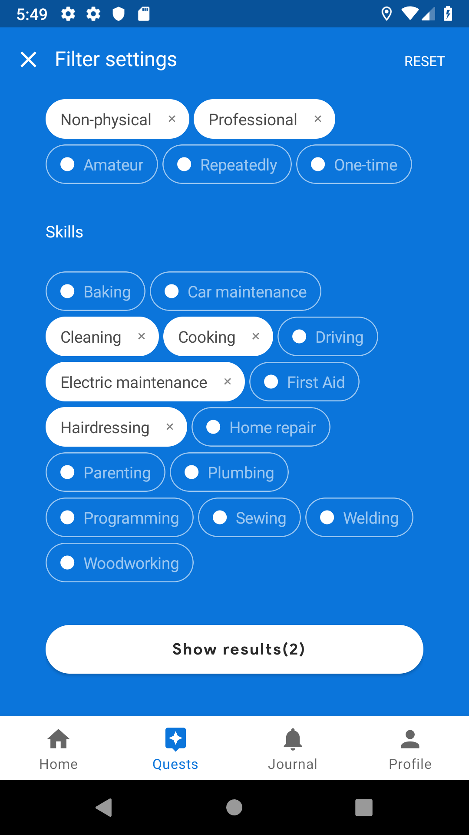
What is it about?
Local hero is the android application with a goal to create platform for people in need and people who are willing to help them and become their local hero.

Slide 3
Tools & Technologies

Slide 4
Video
https://www.youtube.com/watch?v=zDvgXT3GhYo

Slide 5
Thank you

